Slide 1


Transition Considerations
Add Scope
Push data to asqanet to publish to TGA

Slide 2
Transition Considerations
Reg Updates
Add Scope
Push data to asqanet to publish to TGA

Slide 3
Transition Considerations
Reg Updates
Contact Updates
Add Scope
Push data to asqanet to publish to TGA

Slide 4
Transition Considerations
Reg Updates
Contact Updates
Add Scope
Renewal
Push remaining legacy data to ARMS

Slide 5
Transition Considerations
Reg Updates
Contact Updates
Add Scope
Renewal
Market Entry

Slide 6
Transition Considerations
Add Scope
Reg Updates
Contact Updates
Renewal
Market Entry
Push data to asqanet to publish to TGA

Slide 7

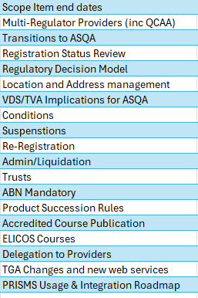
Transition Considerations
Contact Updates
Reg Updates
Renewal
Add Scope
Market Entry

Slide 8
Transition Considerations

